Slide 1

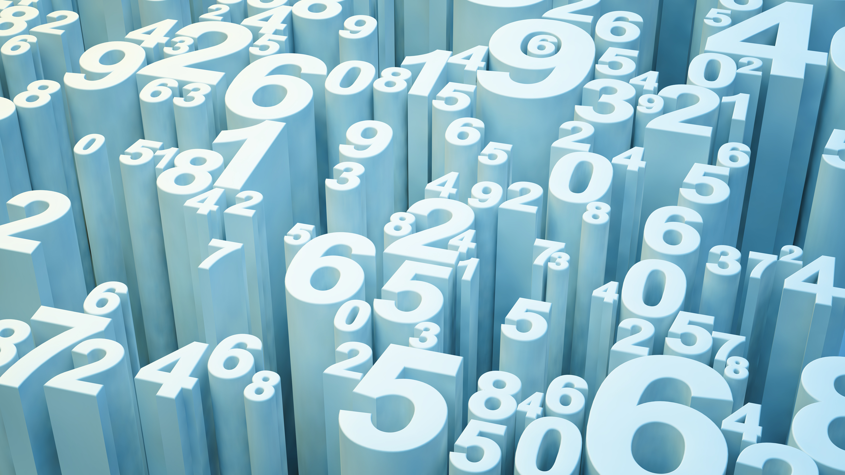
Visual Question Answering System
Project Member:
Faaraan Farid Kazi
Shikshit Gupta

Slide 2
Project Overview
Comprehensive Dataset
Creation
Advanced Multimodal
VQA Model
Significant Contributions to
VQA

Slide 3
Data Source & Collections
We are engineering our data with the help of the transcripts of Professor’s recorded video lecture.
We used deepgram official api to generate speech to text.
We have taken screenshots from the video lecture slide and aligned it with our data transcripts.
We have generated 4000 diverse question answers pair with various contexts and categories.
Our data has been checked and validated by the professor as well.
We have also used multiple models like Questgen to generate these question answer pairs.

Slide 4
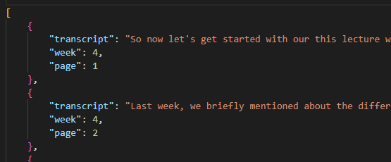
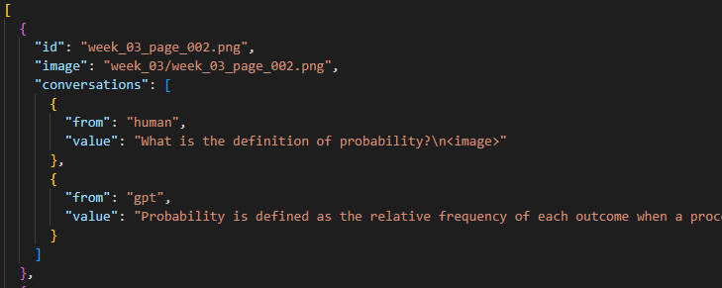
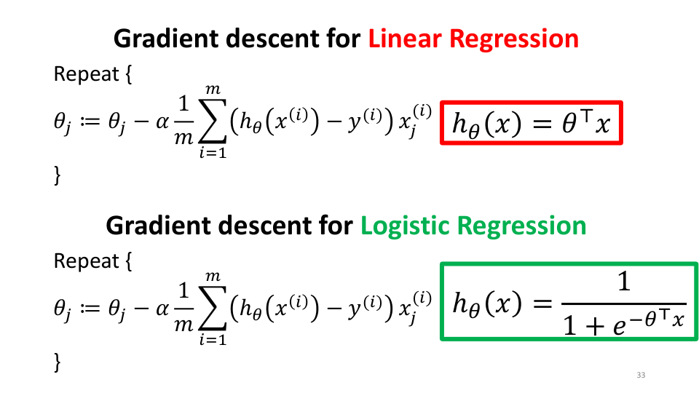
Data Samples
Video Transcript JSON
Llava Model Input JSON
Slide Input Image Sample

Slide 5
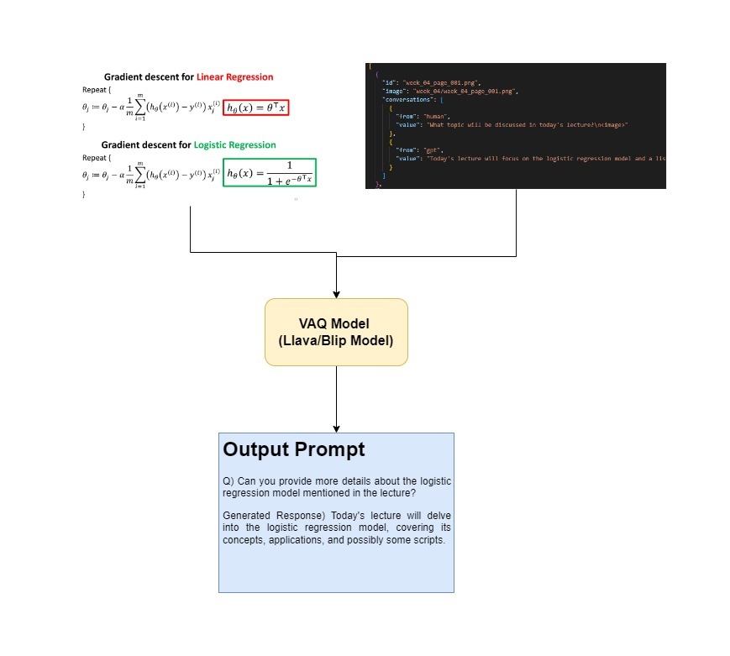
Model Architecture

Slide 6
It’s Demo Time !

Slide 7
Thank You

